Slide 1
PRESENTATION
TITLE
Date | Time
Notes:
Title page photo background can be changed by right clicking on the empty space outside of the slide and selecting “Format Background” then select “Insert” under ”Picture Source” and browse to a new photo that matches your presentation theme.

Slide 2
PRESENTATION
TITLE
Date | Time
Notes:
Title page photo background can be changed by right clicking on the empty space outside of the slide and selecting “Format Background” then select “Insert” under ”Picture Source” and browse to a new photo that matches your presentation theme.

Slide 3
HEADING
Body copy to fill in this space here and here and here and here and here and here and here and here and here and here and here and here and here and here and here and here and here and here and here and here.
HEADING
Body copy to fill in this space here and here and here and here and here and here and here and here and here and here and here and here and here and here and here and here and here and here and here and here.
HEADING
Body copy to fill in this space here and here and here and here and here and here and here and here and here and here and here and here and here and here and here and here and here and here and here and here.
Notes:
This page can be used for presenter photos/bios, section information, or any other content that would fit well.

Slide 4
TEXT/BULLET POINT SLIDE
BULLET 1
Ed ma volest harumet que dis nonsenienis exceribus, conessita illa volorep erchicipsam quunti optat.
BULLET 2
Ihit, tem volesti vent hilique con eum facimet rem volupiti si nos dolenim usanis eos dolluptatur arum si nam dem quid magnam aut volende lliqui omnima imollab oreperit imosam, iusdam acculparum aut qui utem lacerunt eostet moditat uribus eium elis magnatur?
BULLET 3
Ocientist, at velenimus molorio et fuga. Itas endi corrunt velecab ipsum est, temquid mod molorae res aut quia volorpo ssequatur? Quiam et ea et pe quunt que num eat porerumquos dit mod essit explitis sequiaepro magnam, qui cuptate des duciur, ipsam vellit, sum quis intisqui optaqui aeperibea prae solupti commos id eatus
Notes:
For text-heavy/bullet point slides with no imagery

Slide 5
20%
89%
16%
STATISTIC
Body copy to fill in this space here and here and here and here and here and here and here and here and here and here and here and here and here and here and here and here.
STATISTIC
Body copy to fill in this space here and here and here and here and here and here and here and here and here and here and here and here and here and here and here and here.
STATISTIC
Body copy to fill in this space here and here and here and here and here and here and here and here and here and here and here and here and here and here and here and here.
Notes:
This page can be used for facts/figures/statistics other number representation

Slide 6
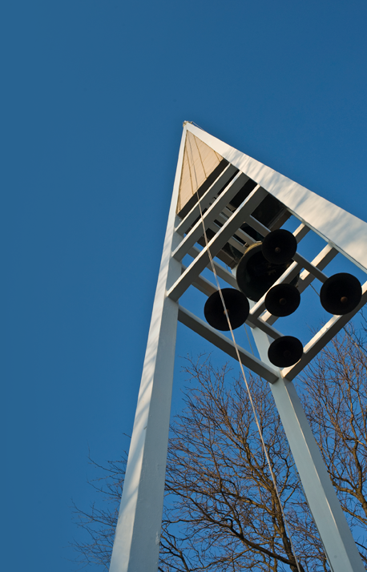
TEXT AND PHOTO SLIDE
Format font/photo/sizes accordingly format font/photo/sizes accordingly format font/photo/sizes accordingly format font/photo/sizes accordingly format font/photo/sizes accordingly format font/photo/sizes accordingly format font/photo/sizes accordingly format font/photo/sizes accordingly format font/photo/sizes accordingly format font/photo/sizes accordingly format font/photo/sizes accordingly format font/photo/sizes accordingly format font/photo/sizes accordingly format font/photo/sizes accordingly format font/photo/sizes accordingly format font/photo/sizes accordingly.
Notes:
Can be used for slides with an image or chart to go along with paragraph text or bullet points.

